Slide 1
Treasury Services
Done by,
Sushmitha U (XBBNLB5)
Sai Akhil G (XBBNLDU)
Mithun J (XBBNLD4)

Slide 2





Notes:
(Treasury Services)
We combine leading treasury solutions, business insights and the latest industry info
to help corporations and institutions optimize cash flows, maintain liquidity, manage risk,
and move money to grow business across global markets.

Slide 3
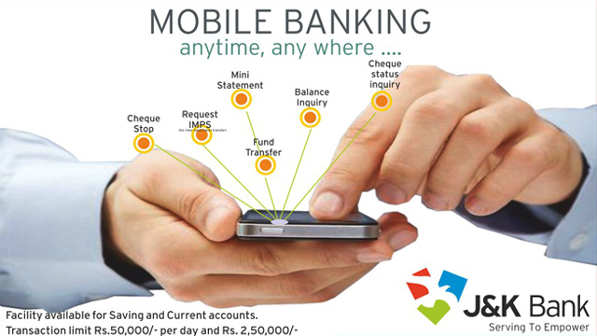

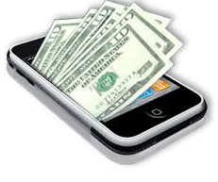




Notes:
(Client Access)
We provide global access to your electronic banking information.
Initiate transactions and receive confirmations
real time access to determine cash position today and previous day
take action on fraudulent
view liquidity over multiple account
maintain user security profiles
improves automation, reduce expenses using remittance.

Slide 4




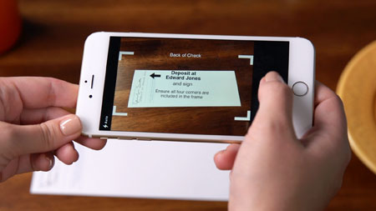
Notes:
(Depository Services)
Consolidate and track deposits from multiple accounting units
Yet only one depository account
Meet your daily cash needs.
Excellent funds availability
leveraging extensive network of banks
Strategic high-speed check process
fast conversion of payments using check deposit service.

Slide 5


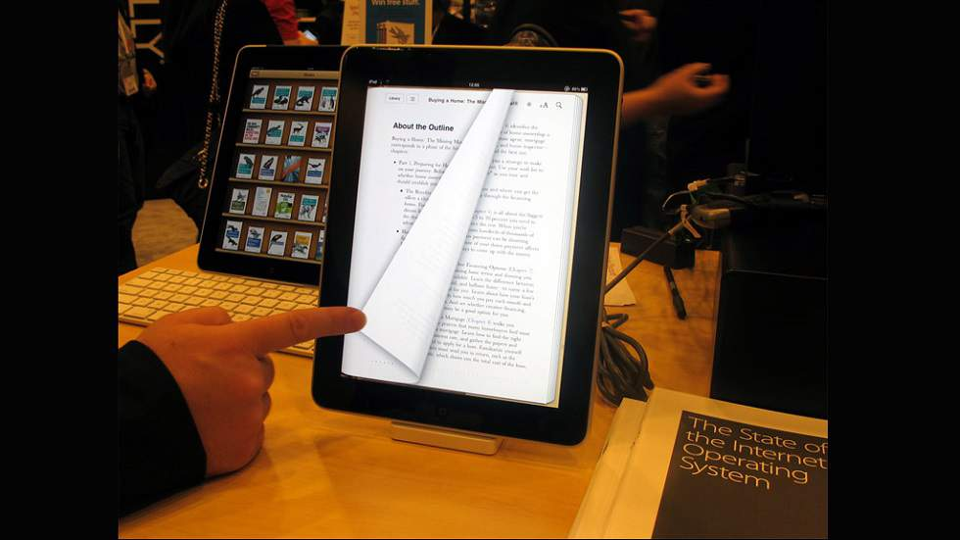



Slide 6





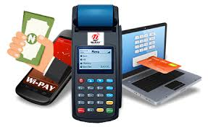
Notes:
(Electronic Services)
Electronic payment - automate, consolidate, fast economic with few errors
convert consumer cheques to ACH
Receive electronic payments
Access nw of payment agents to accept consumer pays
COllect ACH, credits, debits via Elec Receivable Pay Services.

Slide 7





Notes:
(Global Transaction Banking)
Global payments infrastructure for transparency, risk management and stability.
payment on single platform regardless of value, currency, clearing or settlement
European officers are the first to benefit
transfer to GBP funds via CHAPS in May
new cash payment capabilities to address current and future requirements
USD fund transfer services in 50 countries and FX payments in 120 countries

Slide 8






Notes:
(Health care Services)
Consult with payer community
Determine Eligibility
Generate Primary Secondary Claims
Automate the receivable and adjustment process
Capture patient and non patient payments
Manage credit balance and refund

Slide 9

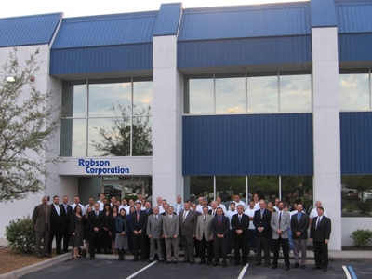
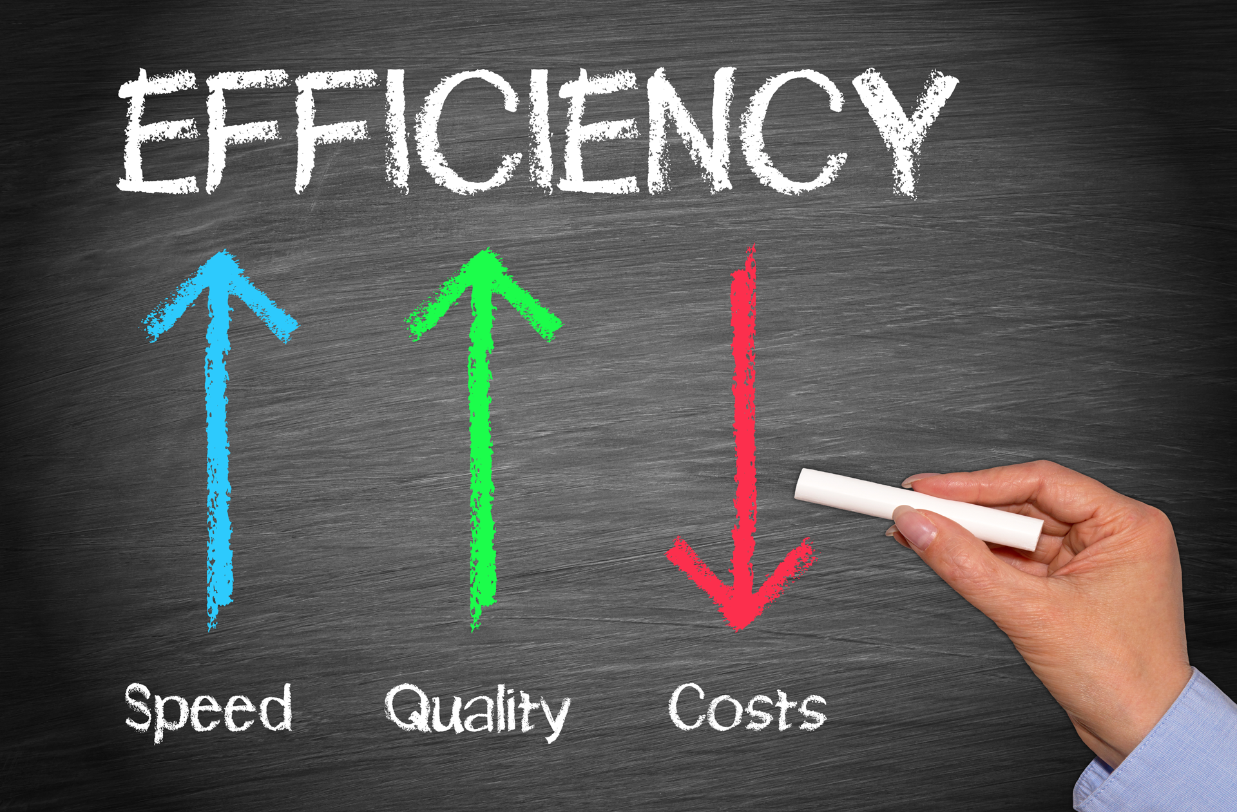





Payables and receivables
Global transaction
Handling finance trades
Notes:
(Industry Solution)
Manage payables & Receivables, execute global transaction, handling trade to meet the
customer needs of global industry
Corporation
Non profit business
Asian or Global financial institution
Non-bank financial
Government agency
reduce costs, facilitate day-to-day business, acheive individual business objectives

Slide 10








Insurance
Insurance
Insurance
Insurance
Cost
Efficiency
Insurance
Costs
Notes:
(Insurance Solution)
solutions to manage the challenges facing insurance industry
reduce costs improve efficiency in non core competency areas
retain and attract customers
Adding tech without increasing costs
reach new generation customers with latest mobile and website
manage fraud
invest working capital.

Slide 11




Notes:
(Investment Sweep)
maximize the investment value of idle(wasted) funds
liquid investment vehicles through the sweep services
Short term investment vehicle
*Repurchase agreements
*Money market mutual funds
*Overnight Eurodollar time deposits
Gain interest immediately while funds are liquid.

Slide 12





Notes:
(Payable Management)
Automate and Control Payment and settlement process
Assist to manage Supplier relationships
Solutions to optimize working capital
Comprehensive solutions including wire transfers, checks and deposits.
E-commerce solutions based on suppliers’ capabilities

Slide 13






Collection rates
Fraud
Notes:
(Payment Execution)
Reduce Unnecessary processing costs and maximize investment returns
using:
Streamline payment processing
Shorten settlement time
Improve collection rates
Reduce the risk of fraud
Improve cash forecasting and reconciliation

